Slide 1
A Major Project on Iot Based Parking System
Submitted by
Kunapareddy Sainath 1051-19-474-057
C.Manohar 1051-19-474-073
S.Keerthi 1051-19-474-077
M.Sai Tharun 1051-19-474-088

Slide 2
Abstract:
Now a days parking a vehicle is became a issues in mall’s and public gathering area.
Efficient and smart way to automate the management of the parking system that allocates an efficient parking space using internet of things technology.
Which gives the Number slots available and Which slot in empty all the information we can easily gather without manual work.

Slide 3
Components:
Arduino
Node MCU
IR sensors
LCD
L293D drive IC
Motors
Power distributors

Slide 4
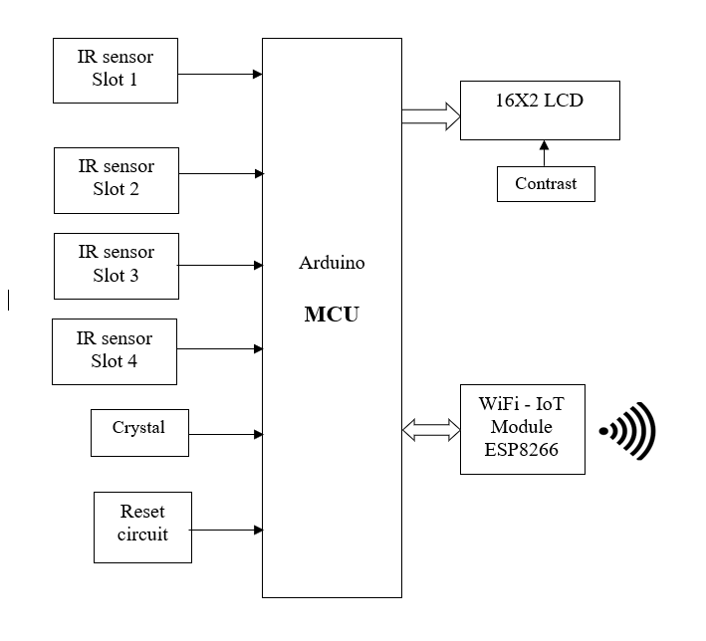
Block diagram:

Slide 5
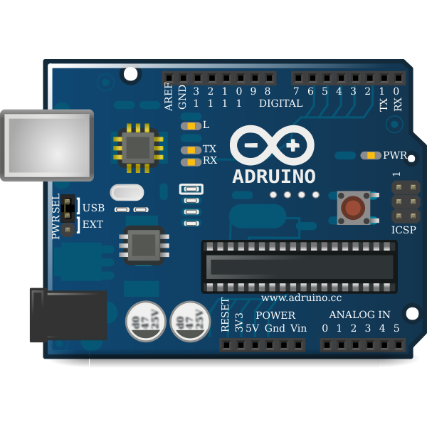
Arduino

Slide 6
Working of Arduino
Arduino is an open source platform used for building electronics projects.
Its consists both physical and programmable circuit board.
Sensors transfer the information, Arduino process the information by program which we have dumped in it.
The processed data is transfer to Node MCU and LCD display.

Slide 7
Features of Arduino
Arduino is a Micro Controller board
It has 14 digital I/O pins
Which is operated in 5voltage
It has 16MHz of clock speed
2Kb of SRAM
Flash memory of 32Kb

Slide 8
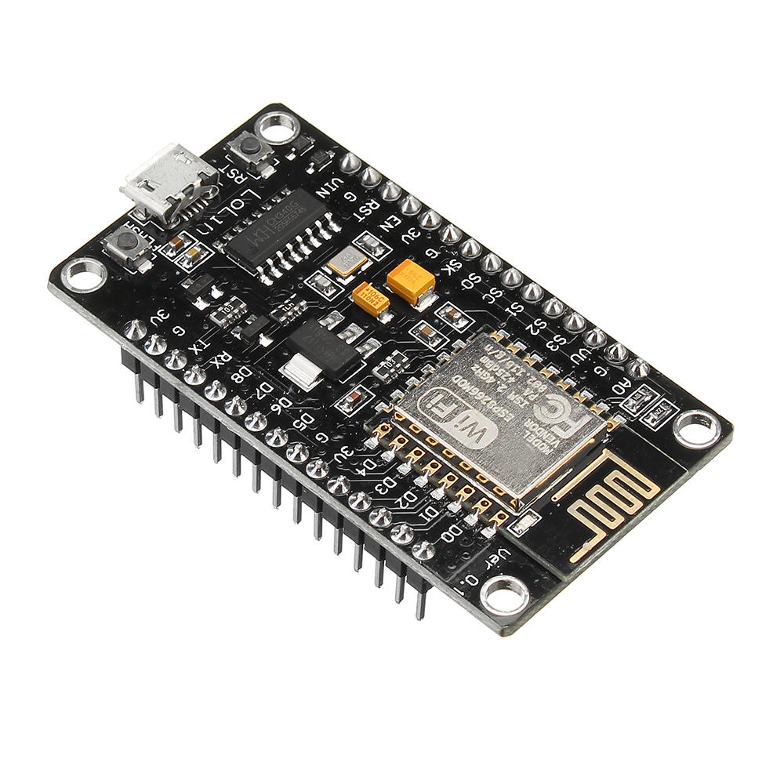
NODE MCU

Slide 9
Working of Node MCU
Node MCU is an open source IoT platform, Which acts as wi-fi module.
The processed information by Arduino is transfer to it and it update on server.
When the both server and Node MCU are connected to same internet.

Slide 10
Features of Node MCU
Its is 16 digital I/O pins.
Flash memory of 4Mb
Clock speed: 80MHz
SRAM:64Kb

Slide 11
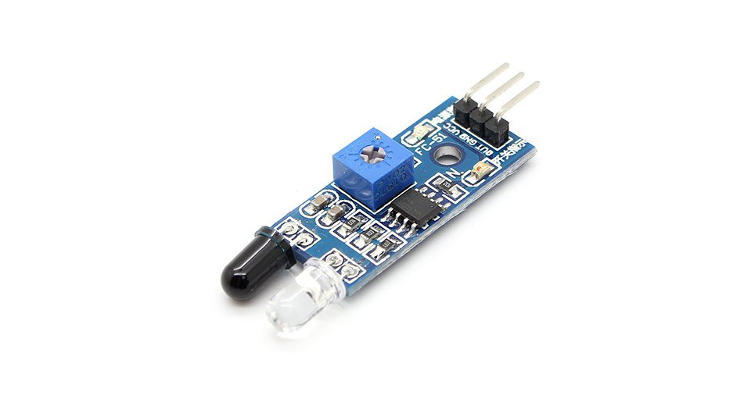
IR Sensors

Slide 12
Features of IR sensor
This sensor is used to detect the object.
Its has receiver(Rx) and transmitter(Tx).
Even it has operational amplifier.
It has a range of 20 centimeter

Slide 13
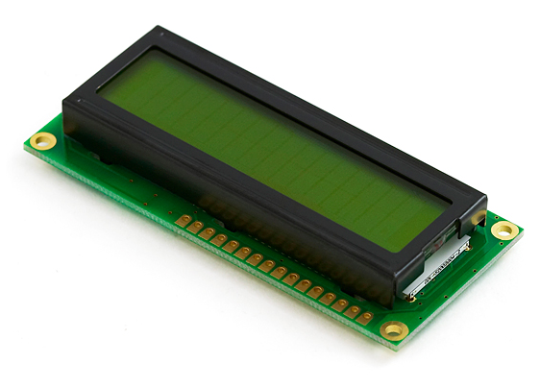
Liquid Crystal Display

Slide 14
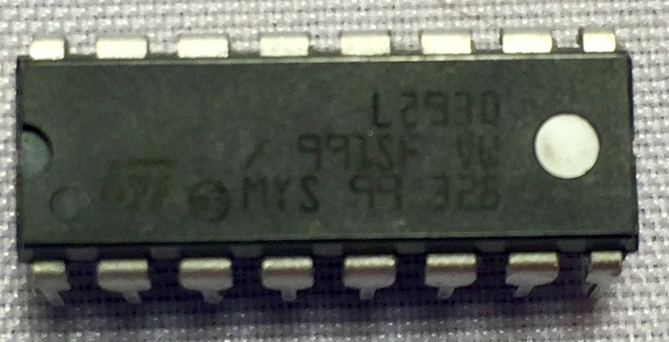
L293 Driver

Slide 15
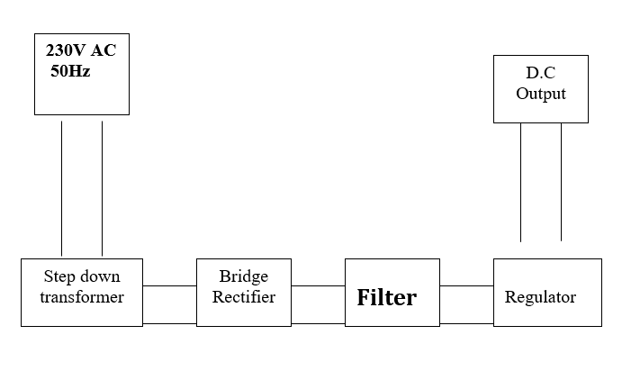
Power Supply
Block diagram

Slide 16
Working Of Power Supply
The General 240v AC is step down by using transformer.
The step down AC voltage is converted to periodical DC voltage by rectifier circuit.
The periodical DC voltage is converted to pure DC voltage by Filters.
To make Pure voltage constant voltage we use regulator.
So, produced DC voltage is provided to applications.

Slide 17
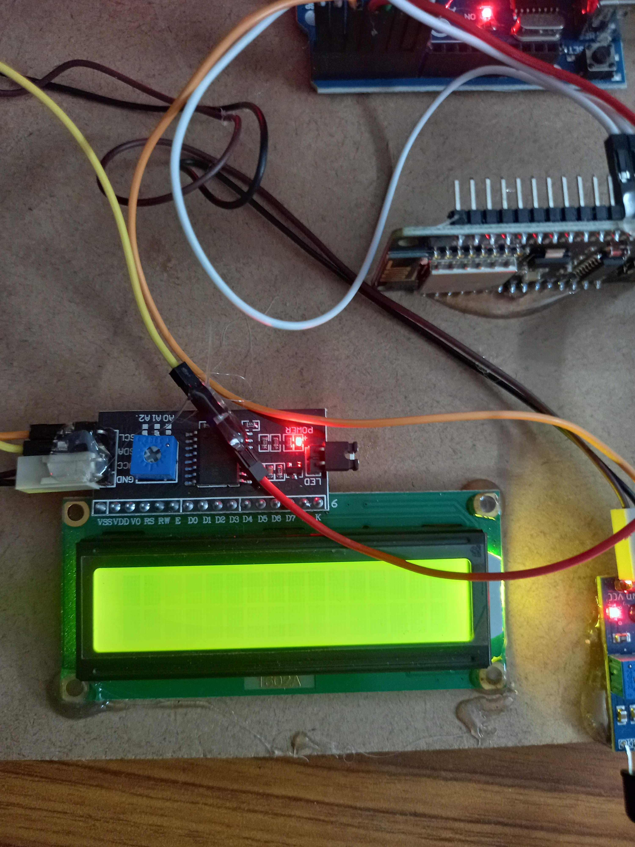
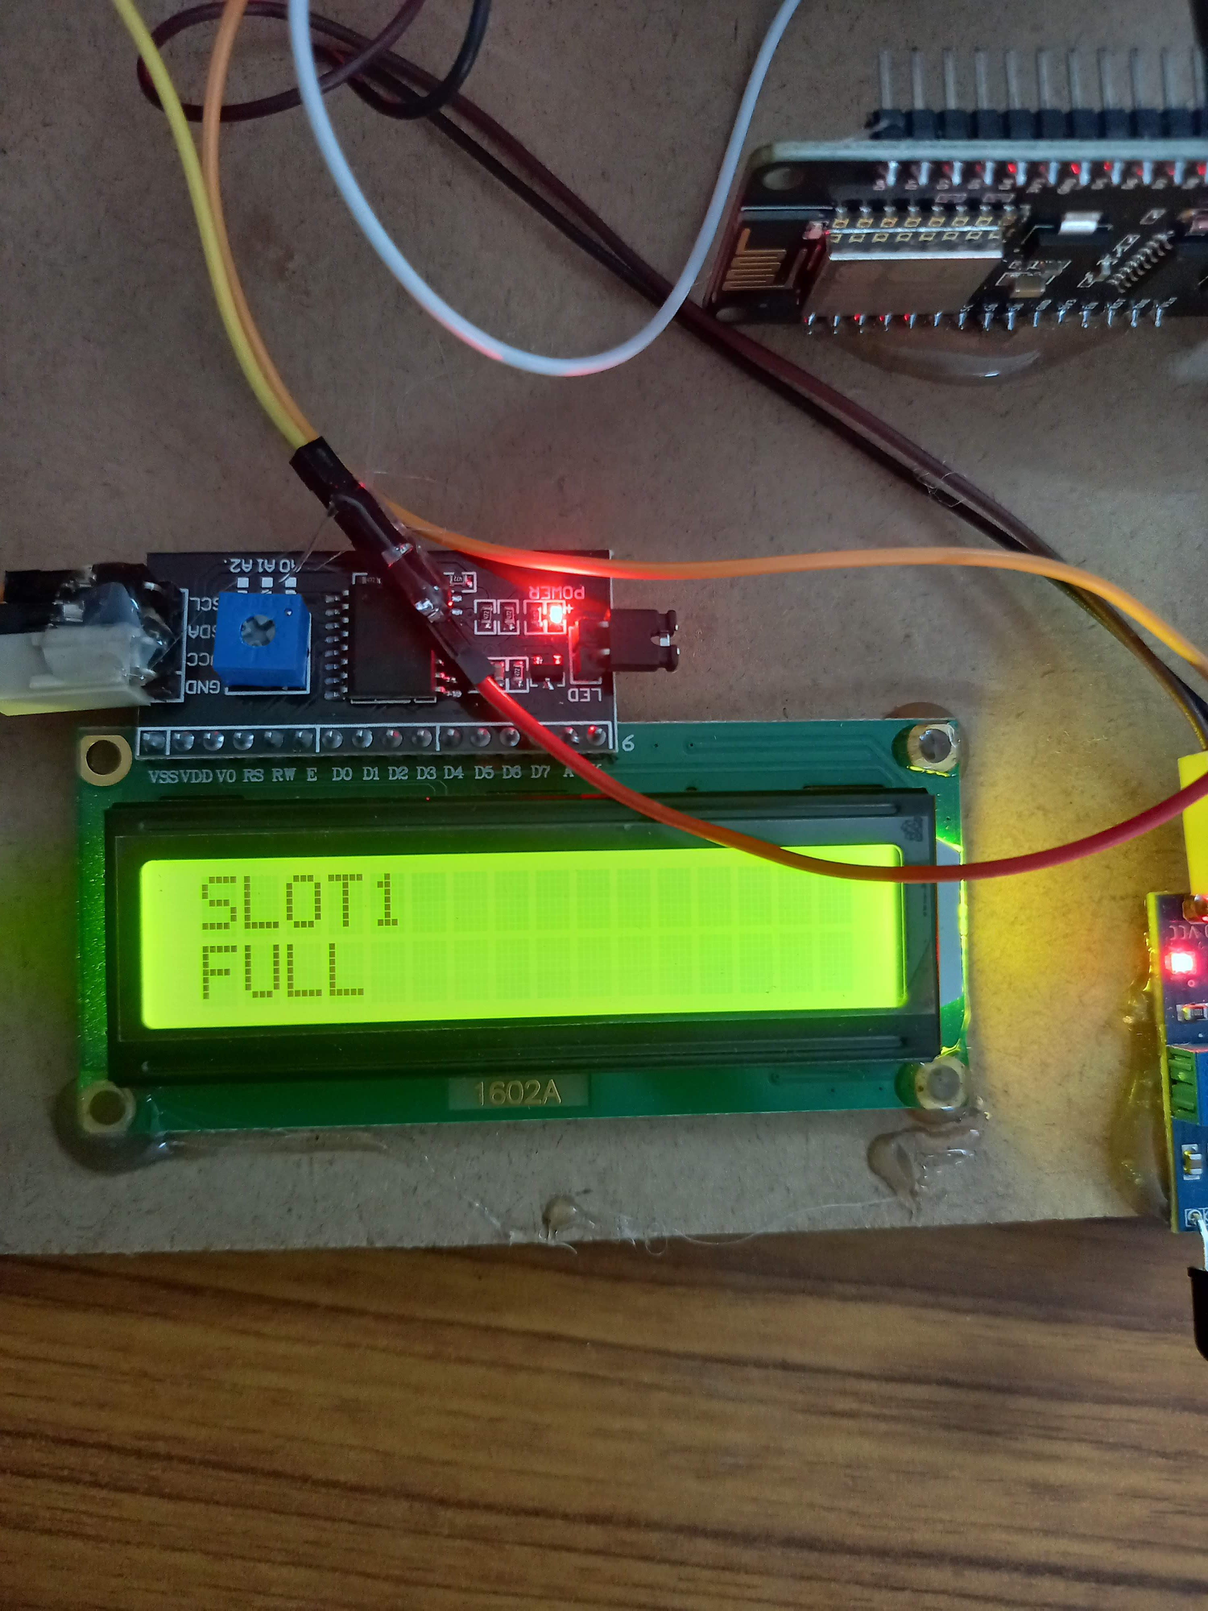
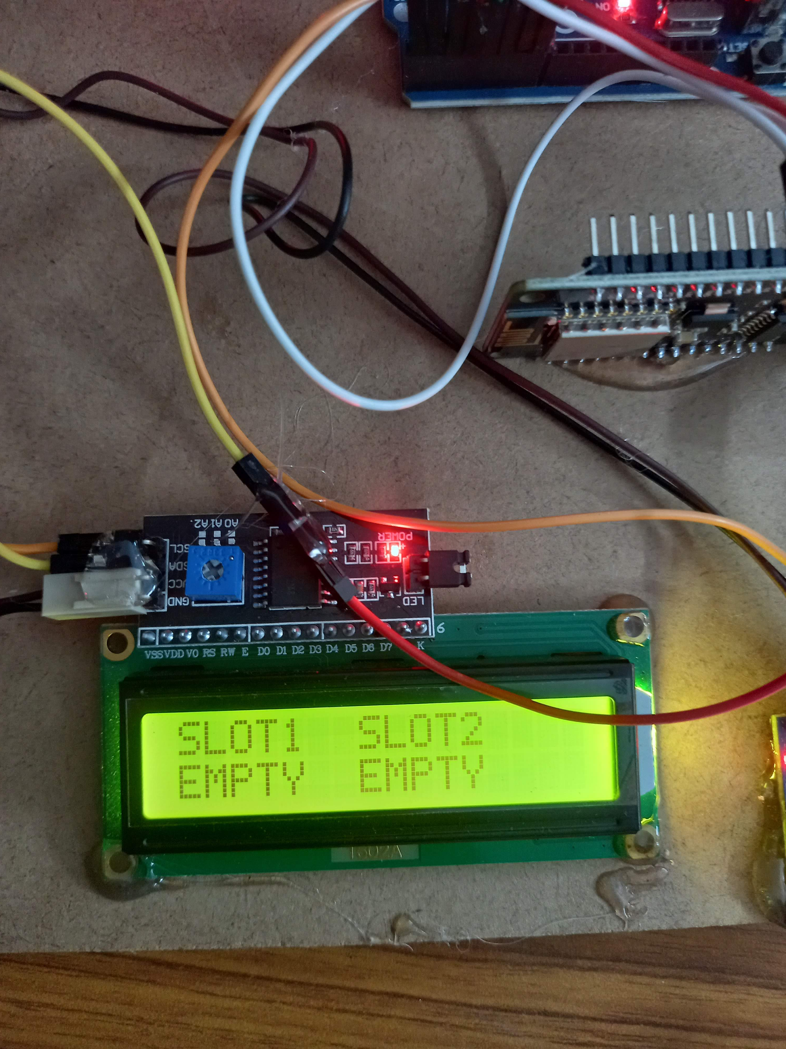
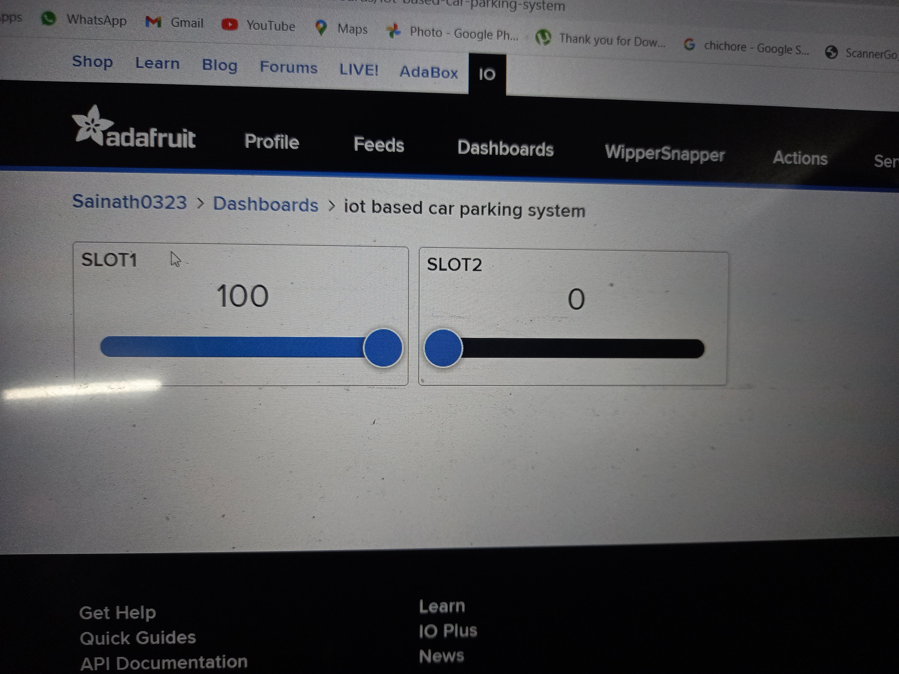
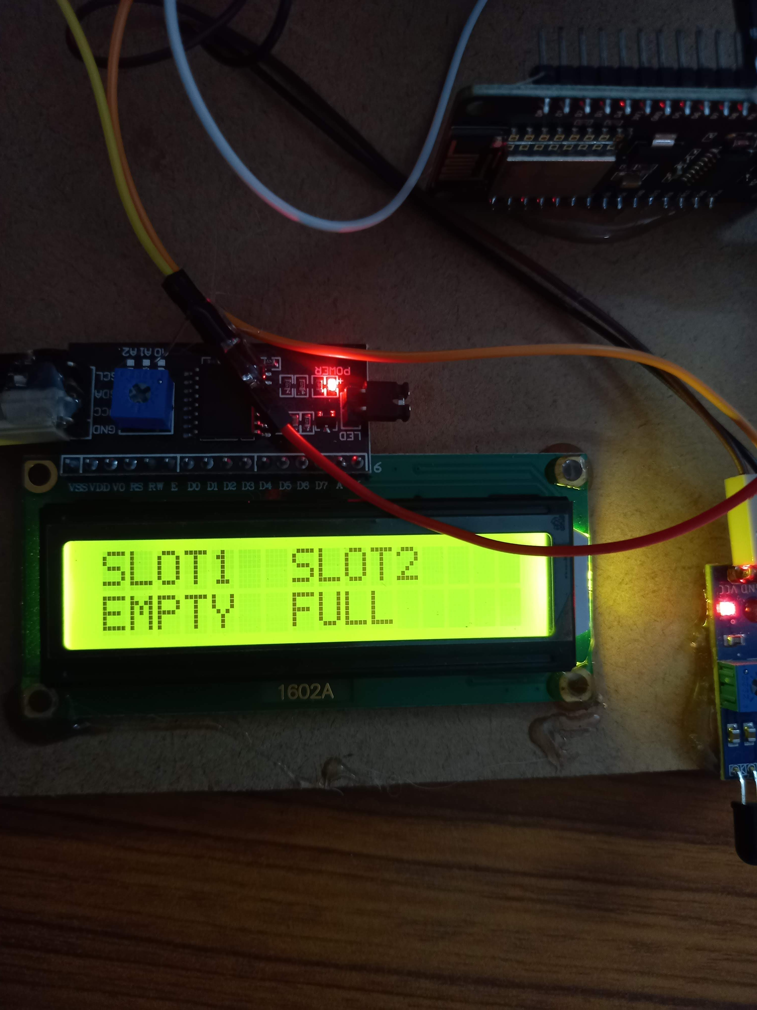
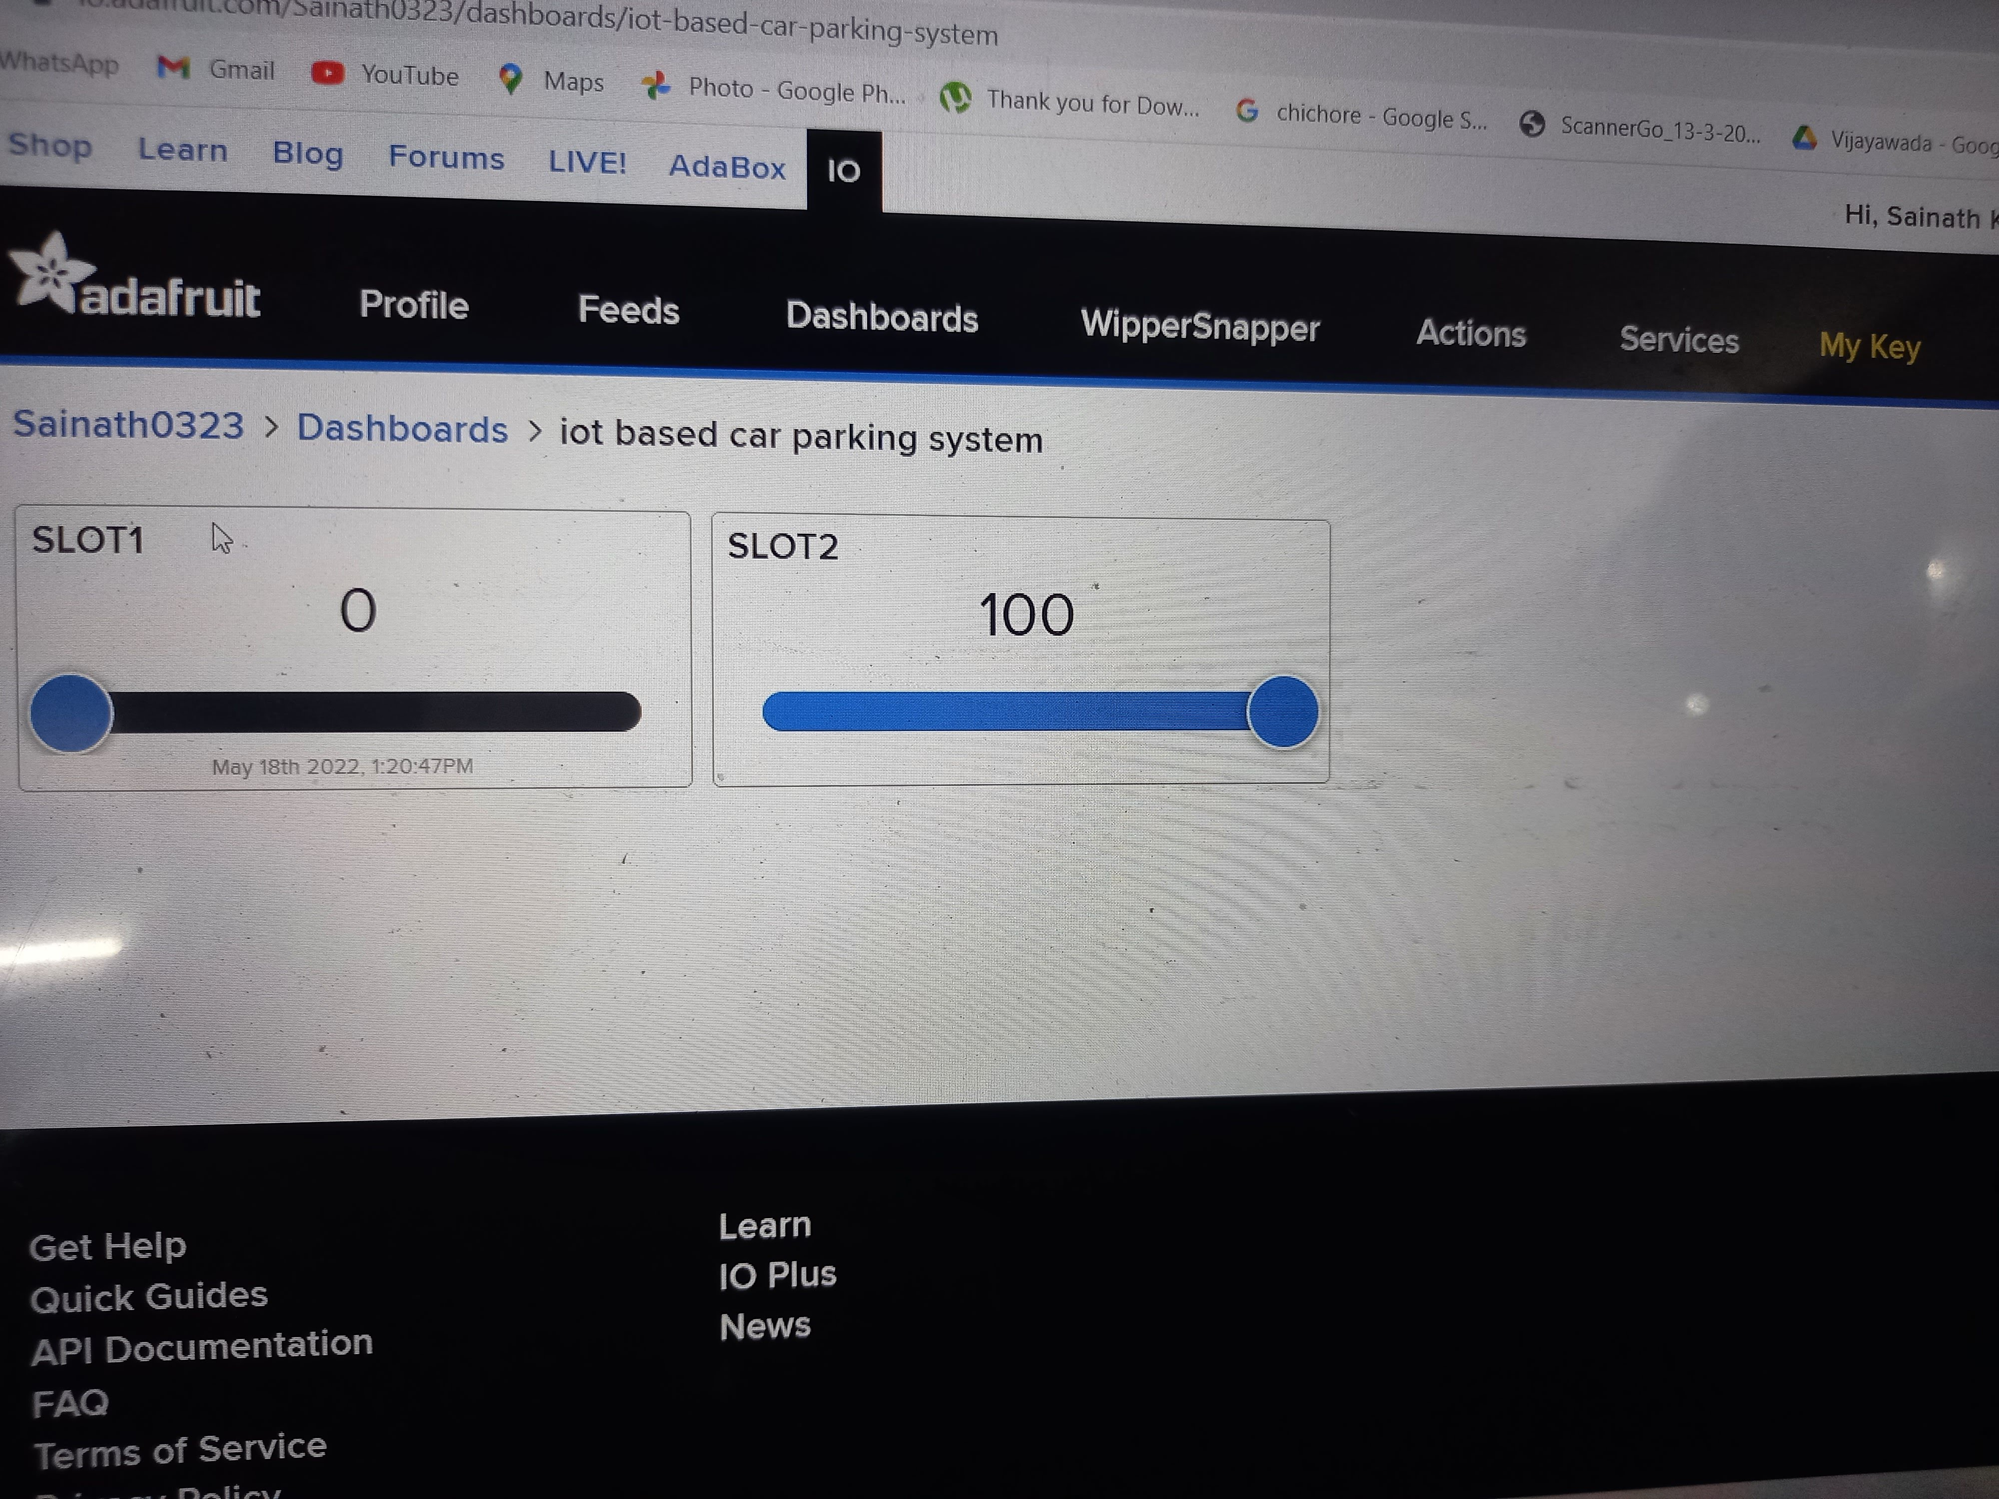
Output :

Slide 18

Thank You

